Slide 1
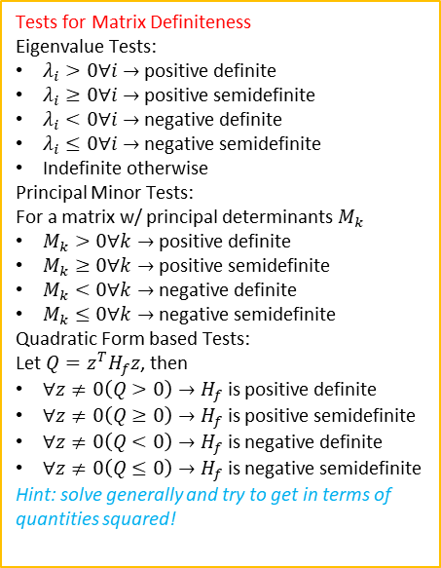

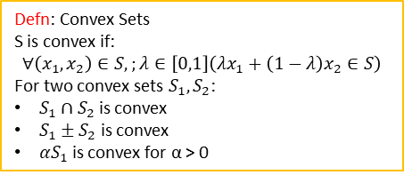
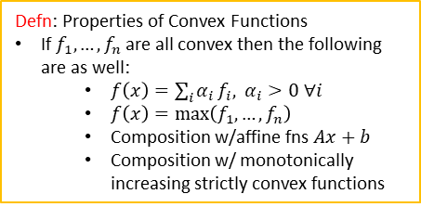
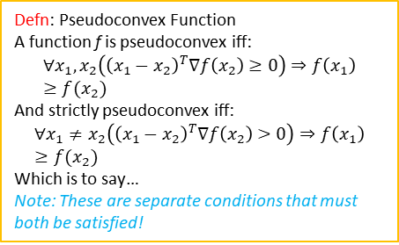

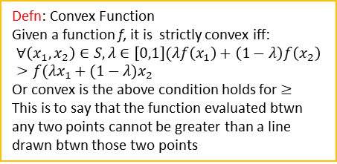
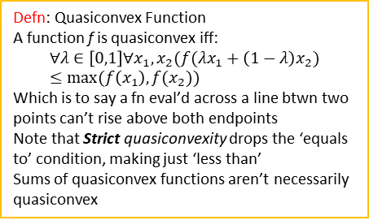
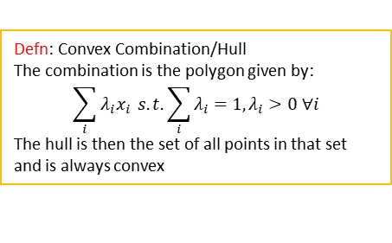
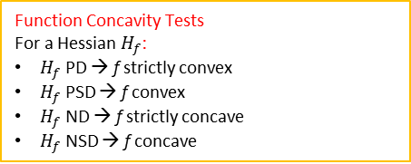

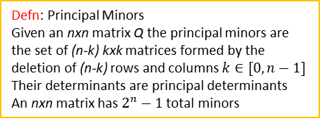
Defn: Line
$$S=\{\vec{x}:\vec{x}=λx_{1}+\left(1−λ\right)x_{2}∀λ\}$$
Tests for Matrix Definiteness
Eigenvalue Tests:
$λ_{i}>0∀i→$ positive definite
$λ_{i}≥0∀i→$ positive semidefinite
$λ_{i}<0∀i→$ negative definite
$λ_{i}≤0∀i→$ negative semidefinite
Indefinite otherwise
Principal Minor Tests:
For a matrix w/ principal determinants $M_{k}$
$M_{k}>0∀k→$ positive definite
$M_{k}≥0∀k→$ positive semidefinite
$M_{k}<0∀k→$ negative definite
$M_{k}≤0∀k→$ negative semidefinite
Quadratic Form based Tests:
Let $Q=z^{T}H_{f}z$, then
$∀z≠0\left(Q>0\right)→H_{f}$ is positive definite
$∀z≠0\left(Q≥0\right)→H_{f}$ is positive semidefinite
$∀z≠0\left(Q<0\right)→H_{f}$ is negative definite
$∀z≠0\left(Q≤0\right)→H_{f}$ is negative semidefinite
Hint: solve generally and try to get in terms of quantities squared!
Defn: Convex Sets
S is convex if:
$$∀\left(x_{1},x_{2}\right)∈S,;λ∈\left[0,1\right]\left(λx_{1}+\left(1−λ\right)x_{2}∈S\right)$$
For two convex sets $S_{1}, S_{2}$:
$S_{1}∩S_{2}$ is convex
$S_{1}±S_{2}$ is convex
${αS}_{1}$ is convex for α > 0
Defn: Convex Combination/Hull
The combination is the polygon given by:
$$\sum_{i}{λ_{i}x_{i}} s.t. \sum_{i}{λ_{i}}=1, λ_{i}>0 ∀i$$
The hull is then the set of all points in that set and is always convex
Defn: Half Space
The two spaces formed above/below a line
$$HS=\{x:a_{n}x≤z\}$$
Strictly Convex
Convex
Defn: Convex Function
Given a function f, it is strictly convex iff:
$$∀\left(x_{1},x_{2}\right)∈S,λ∈\left[0,1\right](λf\left(x_{1}\right)+\left(1−λ\right)f\left(x_{2}\right)>f(λx_{1}+(1−λ)x_{2}$$
Or convex is the above condition holds for $≥$
This is to say that the function evaluated btwn any two points cannot be greater than a line drawn btwn those two points
Strictly Pseudoconvex
Defn: Quasiconvex Function
A function f is quasiconvex iff:
$$∀λ∈\left[0,1\right]∀x_{1},x_{2}(f(λx_{1}+\left(1−λ\right)x_{2})≤max⁡(f\left(x_{1}\right),f(x_{2}))$$
Which is to say a fn eval’d across a line btwn two points can’t rise above both endpoints
Note that Strict quasiconvexity drops the ‘equals to’ condition, making just ‘less than’
Sums of quasiconvex functions aren’t necessarily quasiconvex
Pseudoconvex
Defn: Properties of Convex Functions
If $f_{1},…,f_{n}$ are all convex then the following are as well:
$f\left(x\right)=\sum_{i}{α_{i}}f_{i}, α_{i}>0 ∀i$
$f\left(x\right)=\max\left(f_{1},…,f_{n}\right)$
Composition w/affine fns $Ax+b$
Composition w/ monotonically increasing strictly convex functions
Strictly Quasiconvex
Quasiconvex
Defn: Pseudoconvex Function
A function f is pseudoconvex iff:
$$∀x_{1},x_{2}\left({\left(x_{1}−x_{2}\right)}^{T}∇f\left(x_{2}\right)≥0\right)⇒f\left(x_{1}\right)≥f(x_{2})$$
And strictly pseudoconvex iff:
$$∀x_{1}≠x_{2}\left({\left(x_{1}−x_{2}\right)}^{T}∇f\left(x_{2}\right)>0\right)⇒f\left(x_{1}\right)≥f(x_{2})$$
Which is to say…
Note: These are separate conditions that must both be satisfied!
Defn: Epi-/hypo-graphs
Epigraph is the area above a function
Convex epigraph <-> convex fn
Hypograph is below the function
Convex hypograph <-> concave fn
Defn: Principal Minors
Given an nxn matrix Q the principal minors are the set of (n-k) kxk matrices formed by the deletion of (n-k) rows and columns $k∈[0,n−1]$
Their determinants are principal determinants
An nxn matrix has $2^{n}−1$ total minors
Defn: Bordered Hessian
$$BH=\begin{matrix}0 & ∇f^{T} \\ ∇f & H_{f}\end{matrix}$$
Quasiconvexity Tests
Find the Principal Minors of the bordered hessian, ignoring the first two (i.e. the ones where you – what? for a 3x3 the only determinant that matters is the whole thing, none of the submatrices matter
Function Concavity Tests
For a Hessian $H_{f}$:
$H_{f}$ PD → f strictly convex
$H_{f}$ PSD → f convex
$H_{f}$ ND → f strictly concave
$H_{f}$ NSD → f concave

